Slide 1


Mini Project Phase 1 Presentation “IOT- Based Medical Kit For Paralyzed Patients”
Presented by
Jeevan | 44JK24EC401
Sinchan A | 4JK23EC049
Raksha Rao | 4JK23EC034
Chirag G J | 4JK23EC010
Under the Guidance of
Mr. Harsha C J
Asst. Prof., Dept. of ECE

Slide 2
Contents
Introduction
Problem statement
Objectives
Literature Survey
Methodology
Expected outcome
Applications
Timeline
References

Slide 3
Introduction
Healthcare monitoring for paralyzed patients requires constant support and timely medical attention.
Traditional methods depend on continuous human supervision, which often causes delays in emergency response.
This project addresses these challenges by providing an IoT-based Medical Kit for real-time health tracking and communication.
.

Slide 4
Problem Statement
Paralyzed patients cannot effectively communicate their health needs. Lack of continuous monitoring of vital signs like temperature, heart rate, and IV drip.
Manual observation by caregivers is time-consuming and prone to errors. Delayed detection of emergencies can risk patient safety.
Need for a smart IoT-based solution to provide real-time monitoring and instant alerts. There is a need for an affordable, IoT-based medical kit that enables real-time monitoring and effective communication.

Slide 5
Objectives
Develop a medical kit tailored to the needs of paralyzed patients.
Integrate sensors for monitoring body temperature, heart rate, and IV fluid levels.
Design smart gloves to capture simple gestures for patient–caregiver communication.
Create a cloud-connected system to share real-time health data with medical staff.
Implement an automatic alert mechanism for emergency health situations.
Enhance patient independence while reducing caregiver workload.

Slide 6
Literature Survey
Author [citation] | Title | Methodology | Features | Challenges
[1] | IoT-based Remote Health Monitoring System for Patients | Multiple health sensors ,cloud dashboard | Continuous data access for doctors, emergency alerts | Data privacy, security concerns
[2] | Wearable 2.0: Enabling Human–Cloud Integration in Next Generation Healthcare Systems | Smart gloves with flex sensors connected to microcontroller | Patient–caregiver communication via gestures | Accuracy of gesture detection
[3] | Remote Health Monitoring of Elderly Through Wearable Sensors | Load cell sensor with ESP8266, cloud integration | Automatic IV drip monitoring | Alerts Sensor calibration, reliability
[4] | The Internet of Things for Health Care: A Comprehensive Survey | Combined monitoring of vitals & IoT integration | Multi-sensor kit | Portability Cost, scalability

Slide 7
Methodology
This medical kit consists of following functional units
As follows:
Gesture sensors
Body temperature monitoring System
BPM Monitoring System
I V Drip Monitoring

Slide 8
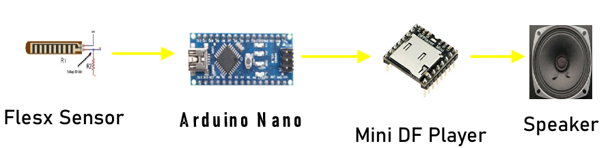
Methodology
Gesture sensor
Block diagram:
Flex sensors detect finger bending.
Node MCU processes sensor data.
Predefined gestures are mapped to patient needs.
Alerts sent to caregivers via Wi-Fi.

Slide 9
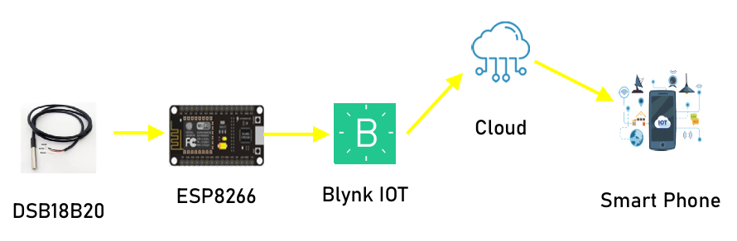
Methodology
2. Body temperature monitoring system
Block diagram:
LM35 sensor measures patient’s body temperature.
Signal fed to Node MCU for processing.
Data displayed on LCD and uploaded to cloud.
Alerts generated if temperature crosses threshold.

Slide 10
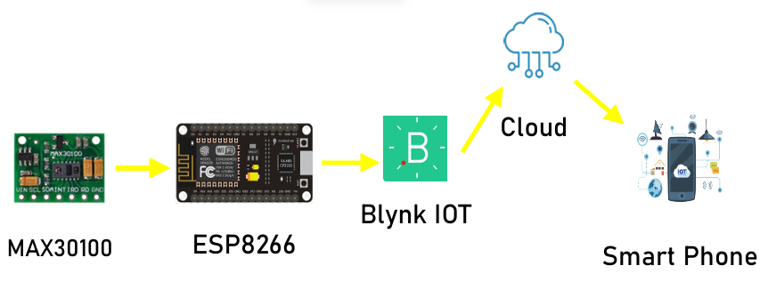
Methodology
3. BPM Monitoring System
Block diagram:
MAX30100 sensor measures pulse rate and oxygen saturation.
Node MCU reads sensor values and filters noise.
Data is shown on LCD and transmitted to cloud.
Emergency alerts triggered for abnormal readings.

Slide 11
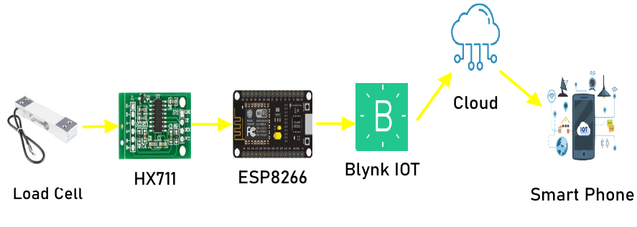
Methodology
4. I V Drip Monitoring
Block diagram :
Load Cell with HX711 measures IV fluid weight.
Node MCU continuously monitors fluid reduction rate.
LCD displays real-time IV level.
Buzzer and cloud alerts activated when fluid is low or empty.

Slide 12
Expected Outcome
1. IoT-Based Medical Kit for Paralyzed Patients
The system will continuously monitor the patient’s body temperature, pulse rate.
Caregivers and medical professionals can access real-time data through a cloud dashboard.
2. Emergency Alerts & Safety
Automatic emergency alerts (email, SMS, phone call) will be generated on abnormal readings or patient gestures.
This ensures enhanced patient safety and timely medical intervention
3. Improved Quality of Care
The system will improve the quality of care in home, hospital, and rehabilitation environments.

Slide 13
Applications
Home Care: Enables families to remotely monitor paralyzed patients.
Hospitals: Reduces manual patient monitoring workload for nurses.
Rehabilitation Centers: Tracks patient recovery and ensures timely support.
Emergency Response: Automatic alerts ensure quick medical attention during critical conditions.
Telemedicine: Doctors can access real-time patient data from anywhere.
Scalable Healthcare: Can be extended to monitor elderly or chronically ill patients.

Slide 14
Time Line
SL NO | DESCRIPTION | TIME
1. | Project planning research and proposal submission | 2nd week of August
2. | Literature survey, Design of functional blocks. | 18th -21th August
3. | Implementation of Smart Gesture and Body Temperature Monitoring | 1st week of October
4. | Implementation of Smart BPM Monitoring and IV drips Monitoring | 2nd Week of November
5. | Submission Of Detailed Report | 2nd Week of November
6. | ECE PROJECT EXPO FINAL DEMO | 2nd Week of November

Slide 15
References
A. Albahri, et al., “IoT-based Remote Health Monitoring System for Patients”, IEEE Access, vol. 8, pp. 216–229, 2020.
M. Chen, Y. Ma, Y. Li, D. Wu, Y. Zhang, and C. Youn, “Wearable 2.0: Enabling Human–Cloud Integration in Next Generation Healthcare Systems”, IEEE Communications Magazine, vol. 55, no. 1, pp. 54–61, 2017.
M. A. Al-Khafajiy, T. Baker, et al., “Remote Health Monitoring of Elderly Through Wearable Sensors”, Future Generation Computer Systems, vol. 98, pp. 89–96, 2019.
S. R. Islam, D. Kwak, M. Hossain, et al., “The Internet of Things for Health Care: A Comprehensive Survey”, IEEE Access, vol. 3, pp. 678–708, 2015.6.

Slide 16
THANK YOU

